Slide 1
Delivery notes
In the notes section under these slides there are some suggested script notes to help delivery.
You can view these in full by going to ‘View’, then selecting ‘Notes Page’ or using the Assembly Script included with the Safer Internet Day 2022 Educational Resources for Ages 11-14 and Ages 14-18.
Before delivering the assembly, you could skip or hide this slide.

Slide 2
Notes:
Today is Safer Internet Day (if applicable). Safer Internet Day is celebrated across the globe in over 170 countries, with thousands of young people joining in across the UK.
The internet is a place where we can go to relax, entertain ourselves and find out more about the world. We can do this alone, with friends or with people from all over the world. It is also a place of fun, laughter and competition, but we know there are negatives too.
That’s why this year’s theme for Safer Internet Day is ‘All fun and games? Exploring respect and relationships online’.

Slide 3
What do you enjoy most about going online?
Notes:
We know that the internet is a really useful tool, but if going online was not fun and entertaining we wouldn’t use it so much. It is the ‘fun and games’ element that often makes us pick up and use our devices, but we also need to think about how people are treated online too.
Let’s start with the positives of being online.
Ask the audience:
What do you enjoy most about being online?
What are the positives/benefits of connecting with others online?

Slide 4
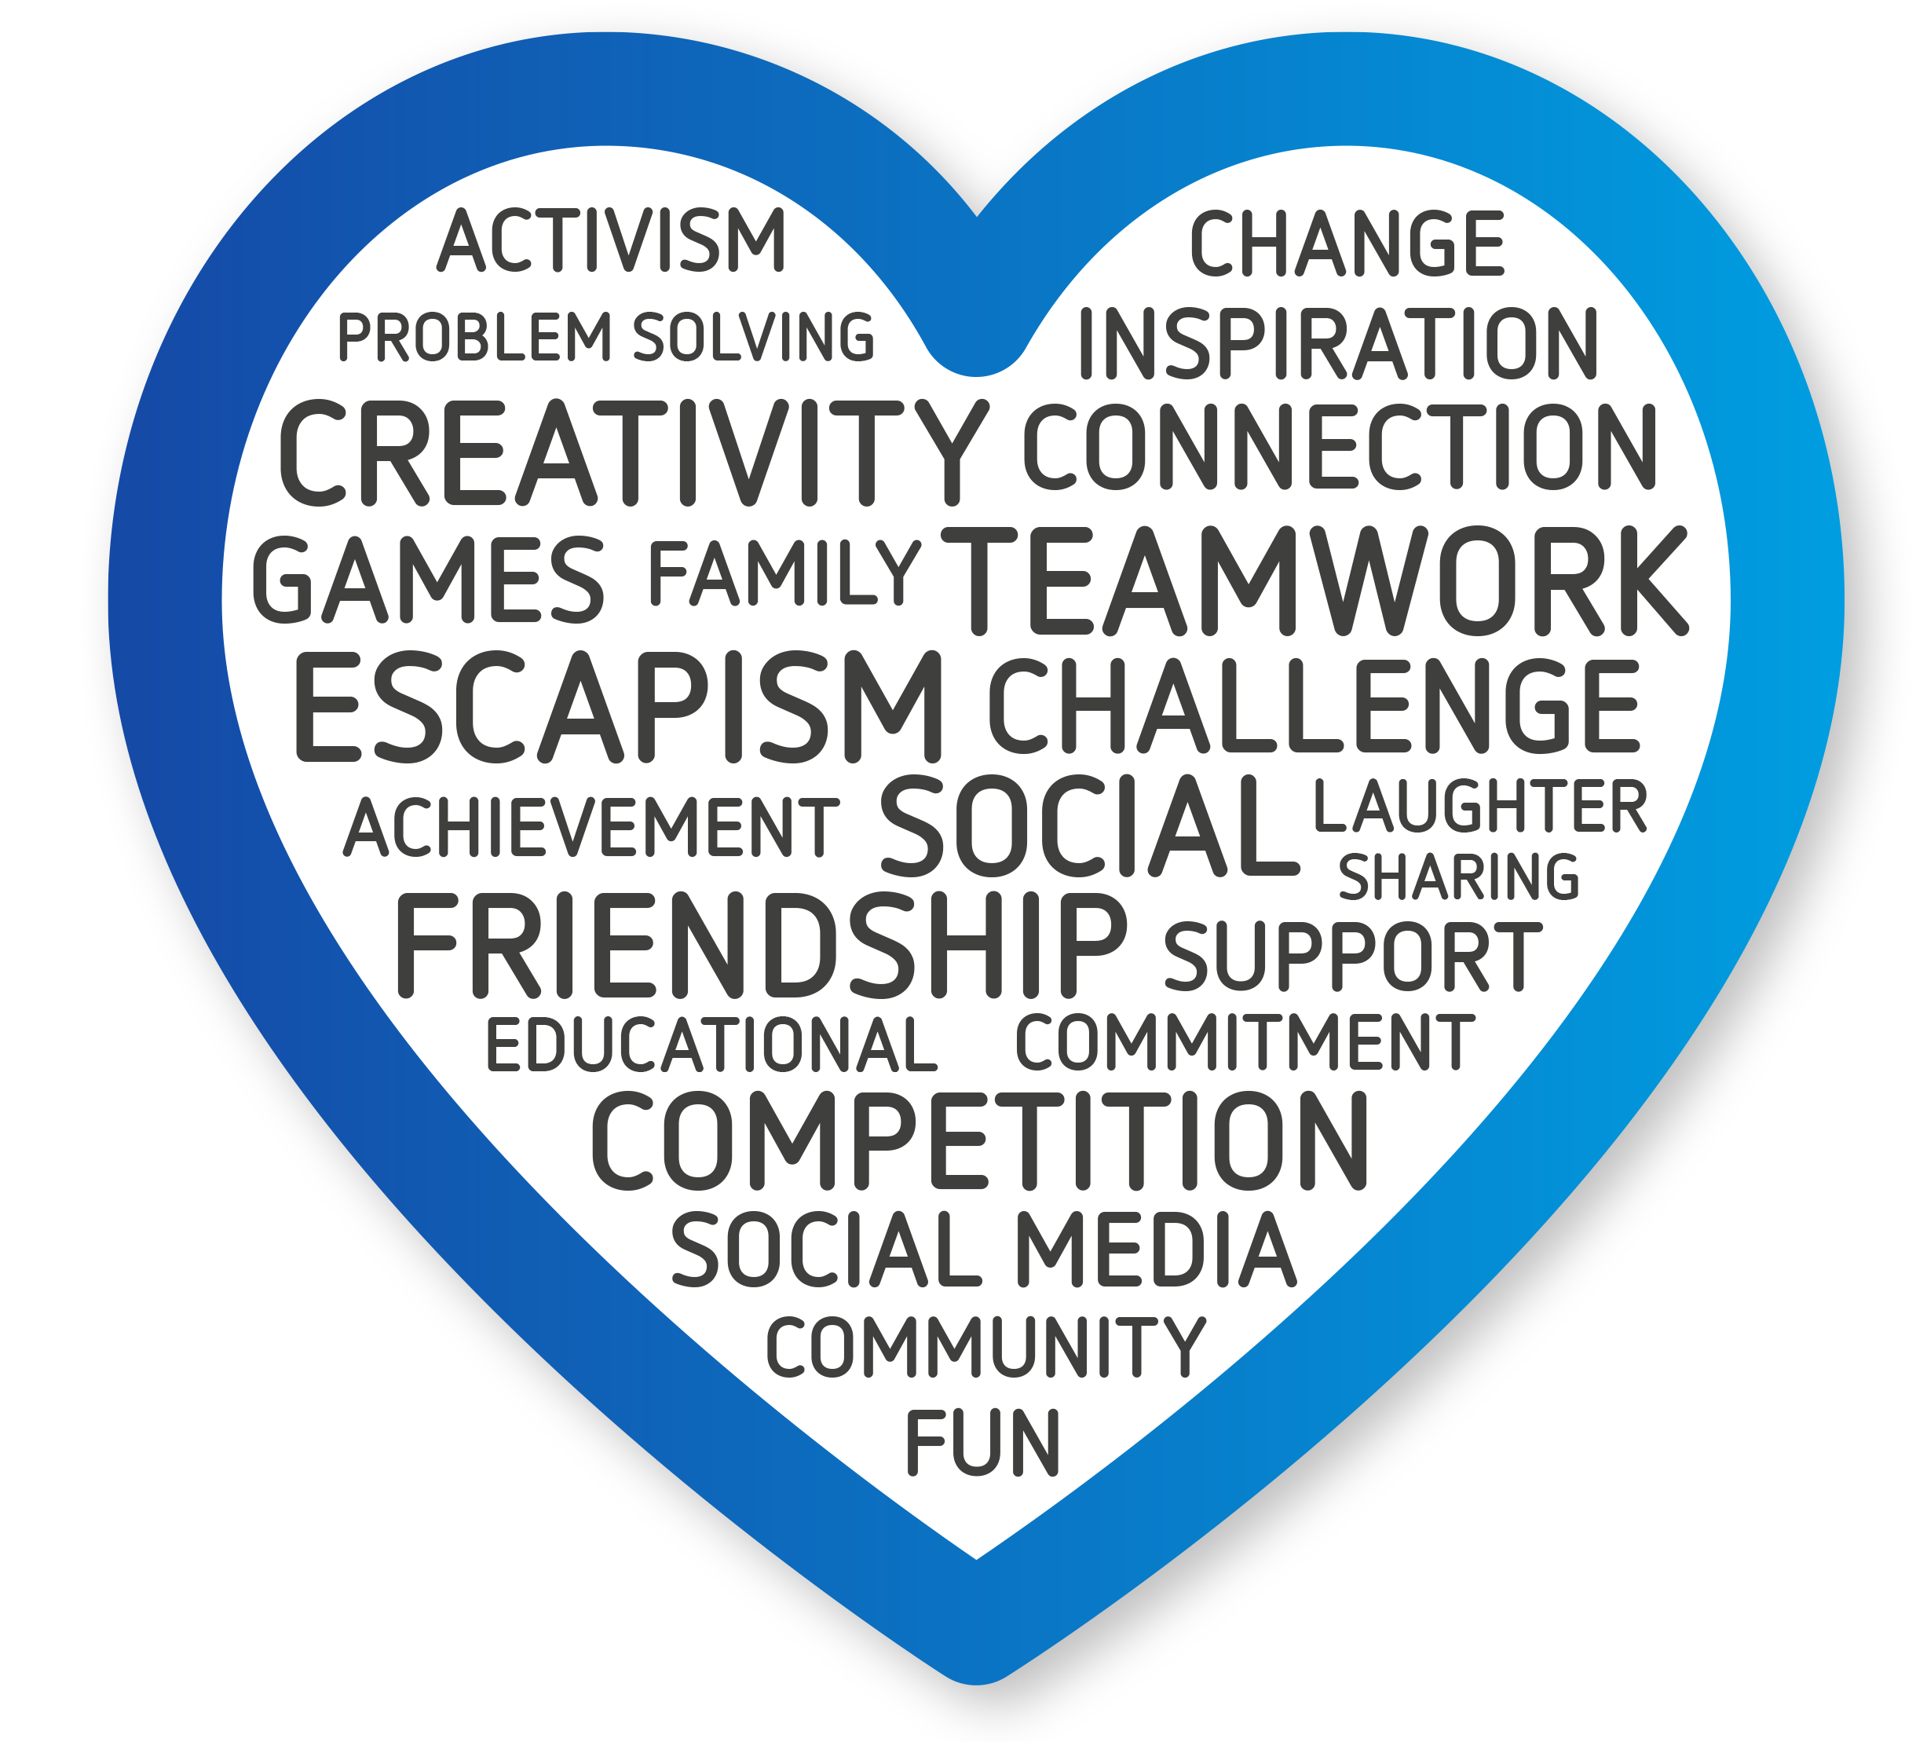
Notes:
Thank you for sharing your favourite aspects of being online and how it can impact relationships.
Going online can make us laugh, help us relax and even escape to another world.
We can share parts of our lives and interact with our idols.
We can compete with others on games or work together.
We can develop our skills by collaborating, persevering and problem solving.
We can learn about other cultures, interact with people from all over the world and from supportive communities.
Many of these positives are about our relationships with others. It is these interactions that can make those moments truly special.
Guidance: Try to highlight any points that the learners made that are in the script or feature in the word cloud.

Slide 5
Respect and relationships online
Source: 8-15 year olds, Ofcom’s Online Nation 2021
Notes:
We’re now going to really explore the issues of respect and relationships online. To do this, we’re going to focus on how people treat each other in gaming.
Now, we realise that some of you may not consider yourselves gamers or you might not play games now, but you probably have played games online before, and you might do again.
The good news is that all perspectives are welcome and that you will also see that a lot of the messages and ideas we look at will work whether you are gaming, using social media or simply chatting to someone online.
As we go through, I want you to keep this question in mind, how can we make gaming and being online a positive experience for all?

Slide 6
How do you think people gain respect in gaming?
Notes:
Let’s start by exploring respect in gaming.
Ask the audience: How do you think people gain respect in gaming?
Guidance: Take responses from the learners. We would expect them to talk about ability being important. They may also talk about how players treat others.
If you have a group who are reluctant to speak, turn it into a choice and ask them to put their hands up to vote.
Ask the question: Do you get the most respect in gaming through ability or through the way you treat others?

Slide 7
Do you think that gaming is an equal playing field?
Are games a space where it does not matter who you are?
Notes:
In gaming you may earn respect through your ability in games. You can also earn respect with the way you treat others, for example how you work with others, how you respond when things go wrong, or how you handle losing.
You could argue that gaming provides an equal playing field. The best players win. Things like age, wealth, race, religion and gender may matter less than they do elsewhere.
Ask the audience: Do you think that gaming is an equal playing field? Are games a space where it does not matter who you are?
Guidance: Aspects of gaming do make it an equal playing field, but it can also be a place where players are subjected to things like homophobia, racism and sexism. Learners may point this out and also say that people can pay to improve their chances in a game.
If you want to break this down further, ask the learners:
Is gaming different to other online spaces like social media, group chats or message boards?
Do looks matter?
Does wealth matter?
Does race matter?
Does gender matter?

Slide 8
have worried about people being mean to them when they are playing
say people are meaner to each other online than in real life
I wish we could get rid of them in real life too
That’s why girls shouldn’t play games
Why did you have to be on my team?
Where are you even from?
You don’t belong here
UK Safer Internet Centre research
Notes:
Whilst it could be argued that games are a space where it does not matter who you are, this is not everyone’s experience.
People can sometimes forget that they are talking to another person when online. With gaming, we know that people can use it to let off steam and playing can make people angry or frustrated.
Nearly half of young people surveyed by the UK Safer Internet Centre worry about people being mean to them when they were playing games.
Some people think it is funny to laugh at a player who is struggling to master a new game. This has led some players to prefer playing alone, rather than competitively.
Just like other online spaces, games can also be used to bully people through mean messages, harassing behaviour or exclusion.
We also know that forms of discrimination like homophobia, racism, sexism, xenophobia and religious hatred can occur in chats and some gaming communities.
This is unacceptable behaviour. It is something that makes people stop playing games and is something people who love gaming want to eradicate too.

Slide 9
Notes:
Let’s pause and reflect on what we’ve covered so far. Being online can be amazing. It allows us to connect with others, but it can also drive people apart or away because not all online spaces are respectful or inclusive.
At this point it would be good to gather some ideas you have about respect and making gaming and being online a positive experience for all.
How can other players be respectful?
How should people treat each other?
Instructions: Take some responses from the learners. If they don’t have any ideas at this stage there will be some suggested steps they can take later on.

Slide 10
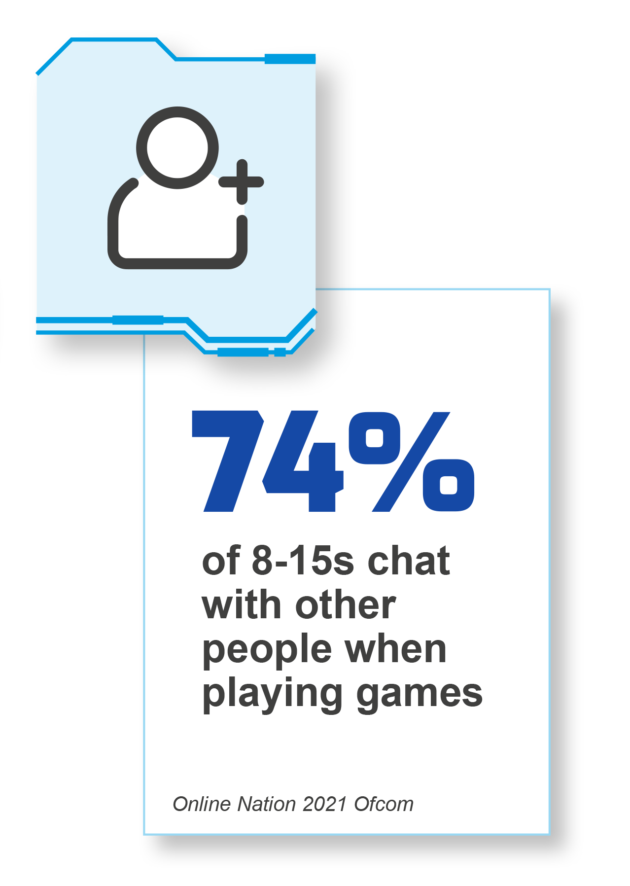
Are you more likely to accept a friend request from someone you don’t know on a game or on social media?
Notes:
Okay – let’s get back to our theme. Now we’re going to think about relationships online, again with a focus on gaming spaces.
For some players, playing against or with real people is one of the best parts of gaming and these could be close friends from school or people they only know online.
In a survey conducted by Ofcom, just under three quarters of players chat whilst playing. Let’s explore what this can lead to, a friend request.
Ask the audience: Are you more likely to send or accept a friend request in a game than you would on social media? Why? Why not?
Is it safer to accept friend requests on a game than on social media?
Guidance: Try to tease out if learners think that it is safer to accept a friend request on a game than it is on social media. Learners are likely to agree and may point out that on social media people can often see a photo of you, your name and be able to learn more about you from things like the bio and photos. This can lead them to feel safer accepting friend requests and do so without really thinking or knowing that person very well on games.

Slide 11
Don’t trust anything you see on the news
I know a great hack for this game
Have you seen this?
We should meet up
Want to chat somewhere else?
Where do you live?
Notes:
Whilst it is certainly true that some people feel safe accepting a friend request from someone they do not know outside of the game, it is not without risk. In addition, some players and communities are not positive.
Ask the audience: How do you keep yourselves safe when interacting with people you don’t know online?
Guidance: Young people often have their own strategies to manage this. Some will not use the chat or their headsets with people they only know in the game. Some will use the report and block tools if that player asks them personal questions, behaves abusively towards them or tries to pressure them in some way. Other important strategies include talking to a trusted adult and reporting negative behaviour that worries them or impacts other players. If they do not mention going to an adult, this may be advice you wish to share or re-iterate.

Slide 12
When chatting with players you only know online, always consider the following:
Be wary of how much personal information you share, particularly any details that allow them to contact you away from the game or locate you offline.
Remember that, regardless of how well you might feel you know someone, not everyone online is who they say they are. It is very risky to agree to meet up offline with them.
If another player says anything or asks you to do anything that makes you feel uncomfortable or worried, then that is not okay.
Notes:
Although playing against or alongside strangers on games is common and can be done safely, it is important to look out for and report players for negative behaviour. That is one way to make gaming an enjoyable experience for all.
It is important to remember that not all people who play games are there to have fun – some may use these online spaces as a way to pressure, trick or intimidate young people.
When chatting with players you only know online, always consider the following:
Be wary of how much personal information you share, particularly any details that allow them to contact you away from the game or locate you offline.
Remember that, regardless of how well you might feel you know someone, not everyone online is who they say they are. It is very risky to agree to meet up offline with them.
If another player says anything or asks you to do anything that makes you feel uncomfortable or worried, then that is not okay.
If you have concerns about how a player is behaving towards you or others, always block them and report them to the game. It is always a good idea to let a trusted adult know too, so they can support you if needed.

Slide 13
Pushing people’s buttons
Notes:
Whether playing with close friends or with a whole range of players, the way we communicate and treat others is a really important part of our experiences online.
This communication can be impacted by many things, such as:
Who we are talking to.
How they are communicating with us.
How we are feeling.
How they are feeling.
Whether the game is going well or poorly.
It could be a friend or a complete stranger but we should manage those relationships with respect and consideration. At times, people can find this a challenge and we are going to explore some reasons why.

Slide 14
It’s only a game
Next
I didn’t want to be on your team
I’ve had enough
Online disinhibition
Die!
You’re rubbish
What are you doing?
Shut up! Loser
Do you look like your character? I hope so
Notes:
‘Online disinhibition’ describes the way that people can behave differently when they are online. You might not recognise the term but you probably recognise the behaviour.
In the heat of battle in a game or through frustration, people can forget how to treat others and that there is a person beyond that screen.
A player may think it is okay to be offensive or abusive to an opponent to put them off because it is ‘just a game’.
Whilst it is a good thing that usernames and avatars allow players to protect their personal information, this anonymity can lead to some people behaving as if there are no consequences to their actions.
But of course, that is not the case.

Slide 15
Notes:
It’s important to remember that despite some of the negatives we’ve considered here, gaming is a great way to relax and can be a fantastic space for socialising with other people.
Plenty of gamers treat others with respect and understand the important of the relationships that exist between them and the other players.
Gaming communities have brought people together and have given people a place where they really belong.
The key is to make all online spaces – including games – a place for everyone.

Slide 16
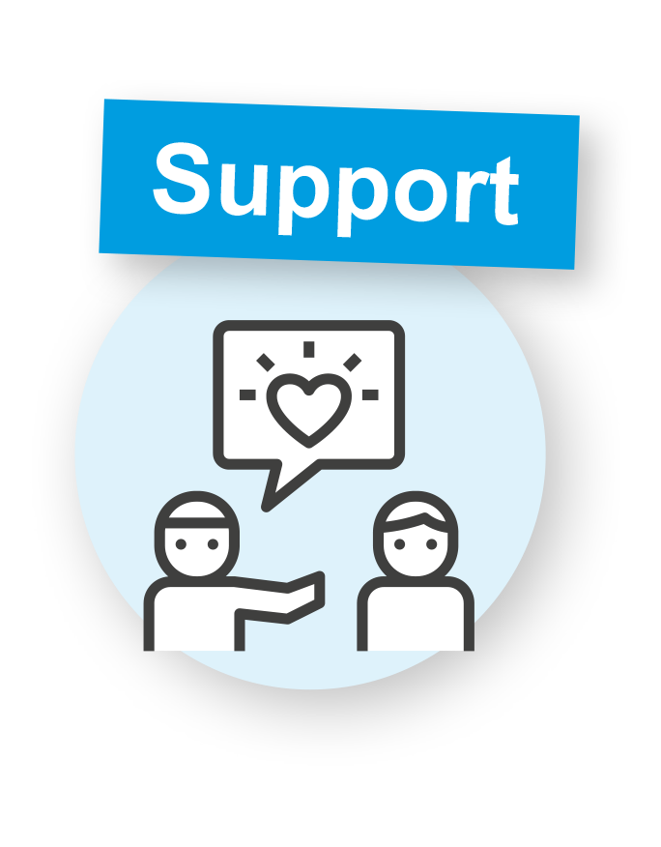
How can we make gaming and being online a positive experience for all?
Notes:
Here are some things that we can all do…
Treat everyone with respect. Own your behaviour and apologise if you upset someone.
Look out for people who are being badly treated. Offer them support and check if they are okay. This could be a private message or one that others can see, if you feel comfortable to do so.
Speak up to remind people that going online should be enjoyable for everyone. It could be reminding other players that they were new to gaming once or that sexual comments on a photo someone posted are not okay.
Report any hate speech or bullying behaviours.
Block people who spread negativity.
As you can see, these are not just tips for gaming, but will work in other online spaces too.
Remember, when we are going online for fun and entertainment, it should be fun and games for everyone.

